Slide 1
SonicSurface Touch-Enabled Interactive Mirrors Using Sound-Based Localization
Team Brogrammers Bolat Ashim
Adi Yerembessov
Azamat Smagulov
Advised by Prof. Insik Shin

Slide 2
Problem Definition
Existing interactive smart mirrors require expensive touch surfaces
Use microphones as an alternative hardware option

Slide 3
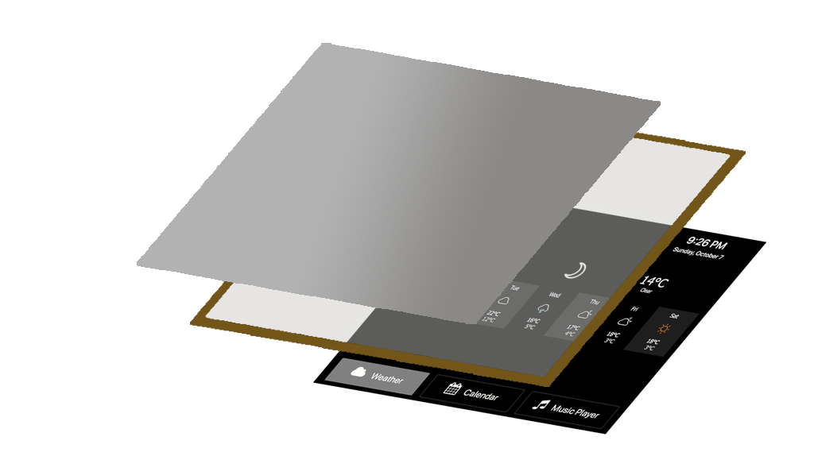
Setup
2-Way Mirror Coating
Glass
App Screen

Slide 4
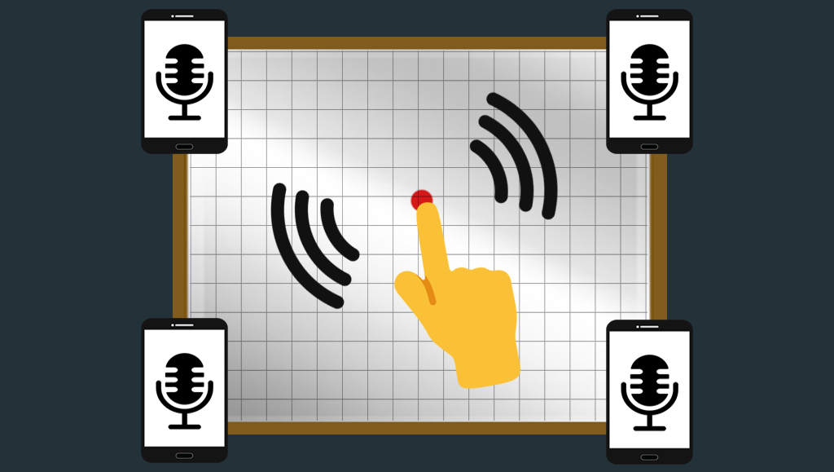
System

Slide 5
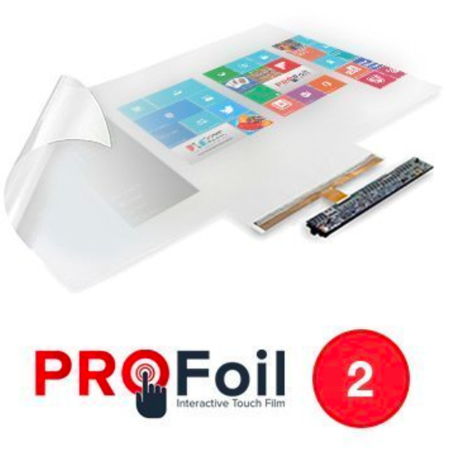
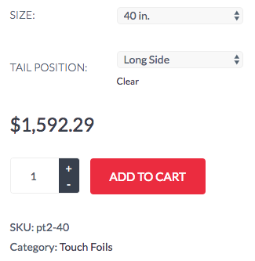
Alternative : Touch Film
www.touchfoil.us

Slide 6
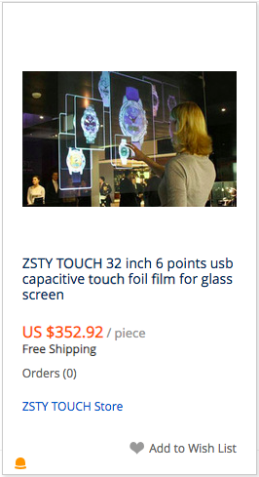
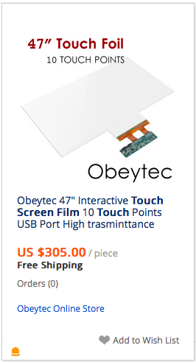
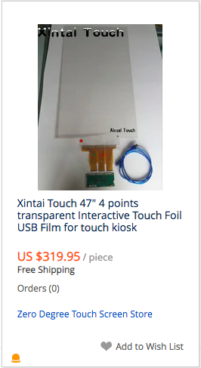
Alternative : Touch Film
aliexpress.com

Slide 7
Touch Film vs Sound Localization
Cost :
Flexibility :
Accuracy :
Sound Localization
Touch Film
Touch Film

Slide 8
SonicSurface 2.0
Applications
Games
Smart Home
Smart Wardrobe

Slide 9
LIVE DEMO
http://appear.in/bolatroom/

Slide 10
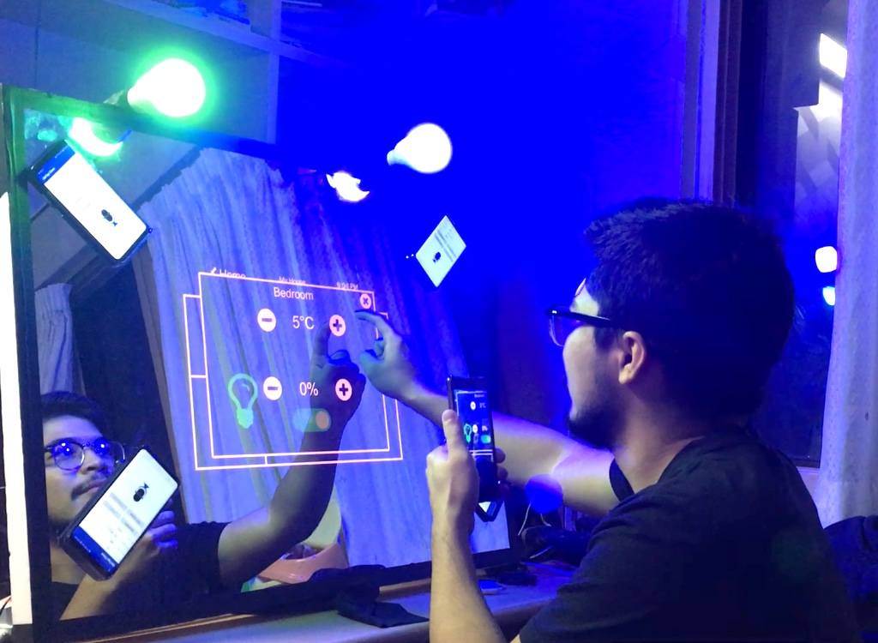
User Study
11 Users
Usability
Accuracy
Satisfaction

Slide 11
Results : Usability
Overall, good (3.5/5) experience.
Very easy to use
Relatively easy
Neutral
Difficult to use
|####
|##########
|########
|
Wow wow wow.
High Tech !

Slide 12
Results : Accuracy
Touch accuracy could be better
Very Accurate
Kinda Accurate
Inaccurate
|##
|##################
|
Sometimes needed to tap hard

Slide 13
Results : Satisfaction
It was kind of fun
Very Satisfied
Kinda Satisfied
Neutral
Not satisfied
|##############
|########
|
|
Awesome work. 10/10, would buy this mirror
A lot of possible use cases

Slide 14
SonicSurface
Breathing Life into Mirrors through Sound . . .

